Slide 1
Processes and Design (KSA)
We hkawng

Slide 2
Project planned schedule (Gantt chart)
Week No. Date. Process Name | 1 (14-20, Oct) | 2 (21-27, Oct) | 3 (28-3, Oct-Nov) | 4 (4-10, Nov) | 5 (11-17, Nov) | 6 (18-24, Nov) | 7 (25-1, Nov-Dec) | 8 (2-8, Dec) | ME & HD | 9 (6-12, Jan) | 10 (13-19, Jan) | 11 (20-26, Jan) | 12 (27-2, Jan-Feb) | 13 (3-9, Feb) | 14 (9-16, Feb) | 15 (17-23, Feb)
Project Proposal
Planning
Gathering requirement data
Designing
Midterm Report
Program Prototyping
Evaluation/Implementation
Finalizing the project
Final Paper and Presentation

Slide 3
Project planned schedule
Week No. Date. Process Name | 1 (14-20, Oct) | 2 (21-27, Oct) | 3 (28-3, Oct-Nov) | 4 (4-10, Nov) | 5 (11-17, Nov) | 6 (18-24, Nov) | 7 (25-1, Nov-Dec) | 8 (2-8, Dec) | ME & HD | 9 (6-12, Jan) | 10 (13-19, Jan) | 11 (20-26, Jan) | 12 (27-2, Jan-Feb) | 13 (3-9, Feb) | 14 (9-16, Feb) | 15 (17-23, Feb)
Project Proposal
Planning
Gathering requirement data
Designing
Midterm Report
Program Prototyping
Evaluation/Implementation
Finalizing the project
Final Paper and Presentation

Slide 4
Project planned schedule
Week No. Date. Process Name | 1 (14-20, Oct) | 2 (21-27, Oct) | 3 (28-3, Oct-Nov) | 4 (4-10, Nov) | 5 (11-17, Nov) | 6 (18-24, Nov) | 7 (25-1, Nov-Dec) | 8 (2-8, Dec) | ME & HD | 9 (6-12, Jan) | 10 (13-19, Jan) | 11 (20-26, Jan) | 12 (27-2, Jan-Feb) | 13 (3-9, Feb) | 14 (9-16, Feb) | 15 (17-23, Feb)
Project Proposal
Planning
Gathering requirement data
Designing
Midterm Report
Program Prototyping
Evaluation/Implementation
Finalizing the project
Final Paper and Presentation

Slide 5
Project planned schedule
Week No. Date. Process Name | 1 (14-20, Oct) | 2 (21-27, Oct) | 3 (28-3, Oct-Nov) | 4 (4-10, Nov) | 5 (11-17, Nov) | 6 (18-24, Nov) | 7 (25-1, Nov-Dec) | 8 (2-8, Dec) | ME & HD | 9 (6-12, Jan) | 10 (13-19, Jan) | 11 (20-26, Jan) | 12 (27-2, Jan-Feb) | 13 (3-9, Feb) | 14 (9-16, Feb) | 15 (17-23, Feb)
Project Proposal
Planning
Gathering requirement data
Designing
Midterm Report
Program Prototyping
Evaluation/Implementation
Finalizing the project
Final Paper and Presentation

Slide 6
Project planned schedule
Week No. Date. Process Name | 1 (14-20, Oct) | 2 (21-27, Oct) | 3 (28-3, Oct-Nov) | 4 (4-10, Nov) | 5 (11-17, Nov) | 6 (18-24, Nov) | 7 (25-1, Nov-Dec) | 8 (2-8, Dec) | ME & HD | 9 (6-12, Jan) | 10 (13-19, Jan) | 11 (20-26, Jan) | 12 (27-2, Jan-Feb) | 13 (3-9, Feb) | 14 (9-16, Feb) | 15 (17-23, Feb)
Project Proposal
Planning
Gathering requirement data
Designing
Midterm Report
Program Prototyping
Evaluation/Implementation
Finalizing the project
Final Paper and Presentation

Slide 7
Design (Flow Chart Diagram for KSA process functions )
Start
End
Yes
User Input = sengseng
No
Check Input Type
Modified Keywords
Prompt for user input
No
User Input = pat
Yes
Prompt for user input
Check Input Type
Prompt for user input
Sign Up and Sign In
No
Have account
Print Response
Produce response
Prompt for user input
Yes
Log In
Regular Greeting
Wish Happy Birthday
No
It’s Birthday
Yes
Load User Data
Check Is Birthday?

Slide 8
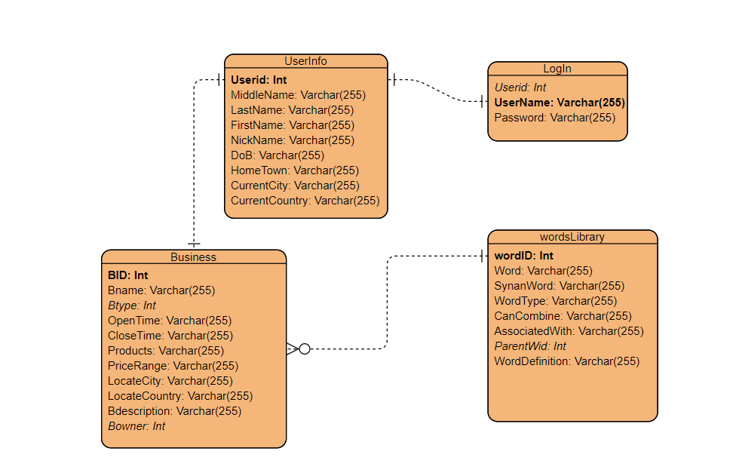
Design (ER Diagram for KSA Database)

Slide 9
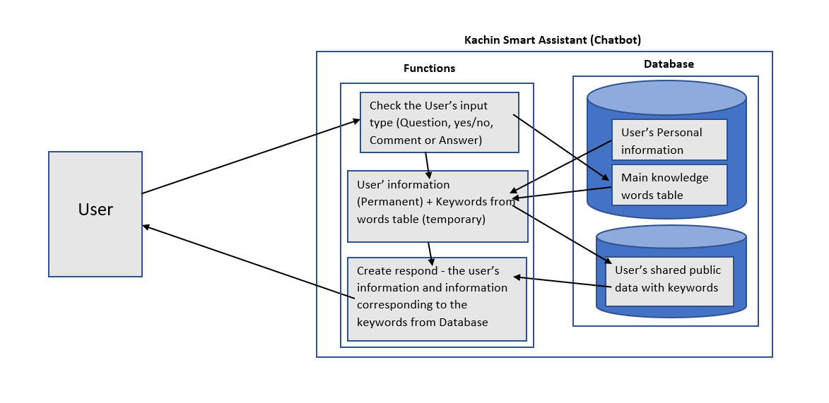
Design diagram for KSA

Slide 10
Project planned schedule
Week No. Date. Process Name | 1 (14-20, Oct) | 2 (21-27, Oct) | 3 (28-3, Oct-Nov) | 4 (4-10, Nov) | 5 (11-17, Nov) | 6 (18-24, Nov) | 7 (25-1, Nov-Dec) | 8 (2-8, Dec) | ME & HD | 9 (6-12, Jan) | 10 (13-19, Jan) | 11 (20-26, Jan) | 12 (27-2, Jan-Feb) | 13 (3-9, Feb) | 14 (9-16, Feb) | 15 (17-23, Feb)
Project Proposal
Planning
Gathering requirement data
Designing
Midterm Report
Program Prototyping
Evaluation/Implementation
Finalizing the project
Final Paper and Presentation

Slide 11
Project planned schedule
Week No. Date. Process Name | 1 (14-20, Oct) | 2 (21-27, Oct) | 3 (28-3, Oct-Nov) | 4 (4-10, Nov) | 5 (11-17, Nov) | 6 (18-24, Nov) | 7 (25-1, Nov-Dec) | 8 (2-8, Dec) | ME & HD | 9 (6-12, Jan) | 10 (13-19, Jan) | 11 (20-26, Jan) | 12 (27-2, Jan-Feb) | 13 (3-9, Feb) | 14 (9-16, Feb) | 15 (17-23, Feb)
Project Proposal
Planning
Gathering requirement data
Designing
Midterm Report
Program Prototyping
Evaluation/Implementation
Finalizing the project
Final Paper and Presentation

Slide 12
Project planned schedule
Week No. Date. Process Name | 1 (14-20, Oct) | 2 (21-27, Oct) | 3 (28-3, Oct-Nov) | 4 (4-10, Nov) | 5 (11-17, Nov) | 6 (18-24, Nov) | 7 (25-1, Nov-Dec) | 8 (2-8, Dec) | ME & HD | 9 (6-12, Jan) | 10 (13-19, Jan) | 11 (20-26, Jan) | 12 (27-2, Jan-Feb) | 13 (3-9, Feb) | 14 (9-16, Feb) | 15 (17-23, Feb)
Project Proposal
Planning
Gathering requirement data
Designing
Midterm Report
Program Prototyping
Evaluation/Implementation
Finalizing the project
Final Paper and Presentation

Slide 13
Project planned schedule
Week No. Date. Process Name | 1 (14-20, Oct) | 2 (21-27, Oct) | 3 (28-3, Oct-Nov) | 4 (4-10, Nov) | 5 (11-17, Nov) | 6 (18-24, Nov) | 7 (25-1, Nov-Dec) | 8 (2-8, Dec) | ME & HD | 9 (6-12, Jan) | 10 (13-19, Jan) | 11 (20-26, Jan) | 12 (27-2, Jan-Feb) | 13 (3-9, Feb) | 14 (9-16, Feb) | 15 (17-23, Feb)
Project Proposal
Planning
Gathering requirement data
Designing
Midterm Report
Program Prototyping
Evaluation/Implementation
Finalizing the project
Final Paper and Presentation

Slide 14
Project planned schedule
Week No. Date. Process Name | 1 (14-20, Oct) | 2 (21-27, Oct) | 3 (28-3, Oct-Nov) | 4 (4-10, Nov) | 5 (11-17, Nov) | 6 (18-24, Nov) | 7 (25-1, Nov-Dec) | 8 (2-8, Dec) | ME & HD | 9 (6-12, Jan) | 10 (13-19, Jan) | 11 (20-26, Jan) | 12 (27-2, Jan-Feb) | 13 (3-9, Feb) | 14 (9-16, Feb) | 15 (17-23, Feb)
Project Proposal
Planning
Gathering requirement data
Designing
Midterm Report
Program Prototyping
Evaluation/Implementation
Finalizing the project
Final Paper and Presentation

Slide 15
Thank You

